Slide 1


SALES DATASET ANALYSIS-ADVANCED EXCEL PROJECT
PRESENTED BY JEEVANANTHAM.R
DATE:23.06.2025
COURSE:DATA ANALYST AND DATA SCIENTIST
BATCH:RP-36,MAY BATCH
1

Slide 2

PROJECT OVERVIEW:
TO ANALYZE SALES DATA TO IDENTIFY TRENDS.
TO PROVIDE ACTIONABLE BUSINESS INSIGHTS.
TO IDENTIFY HIGH PERFORMING PRODUCTS AND SALES CHANNEL.
THE IMPACT OF RETURNS AND DISCOUNTS.
TO CREATE A DYNAMIC DASHBOARD WITH KEY METRICS.
TO UNDERSTAND SALES PERFORMANCE.
TO ANALYZE SALES OVER TIME.
2

Slide 3
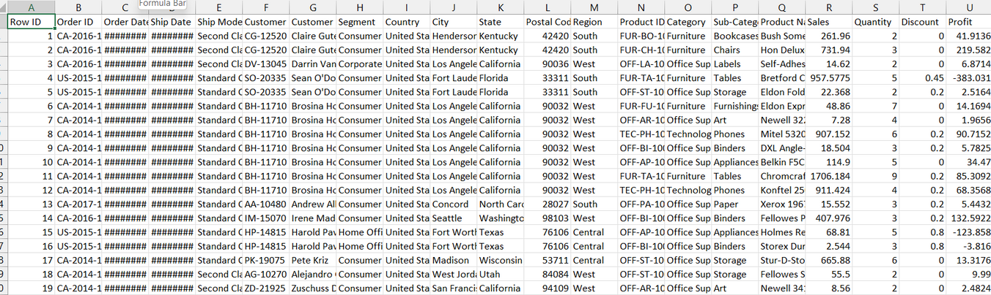
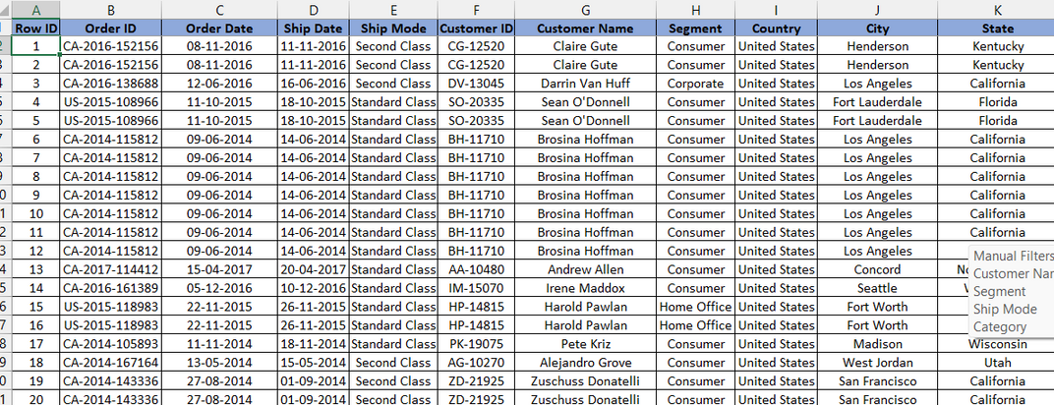

DATA DESCRIPTION AND PREPARATION:
DATASET OVERVIEW:
DATA OF 9994 ROWS,COLUMNS HAS PRODUCT ID,CUSTOMER ID,SALES,DISCOUNT ETC..,
DATA CLEANING PROCESS:
1.REMOVE DUPLICATES:WE REMOVE ANY DUPLICATE VALUE IN THE DATA BY REMOVE DUPLICATES IN THE DATA TAB.
2.MISSING VALUES:WE CAN IDENTIFY MISSING VALUES BY PRESS CTRL+G->THE DIALOG BOX OPENS->THEN CLICK SPECIAL->THEN CLICK BLANKS->OK.
3.DATA FORMATTING:WE CAN FORMAT THE DATA FOR CLEAR REFERENCES.WE HAVE TO FORMAT THE DATE TO SHORT DATE,AND WE CAN FORMAT NAMES TO UPPERCASE() ETC..,
BEFORE CLEANING:
AFTER CLEANING:
3

Slide 4





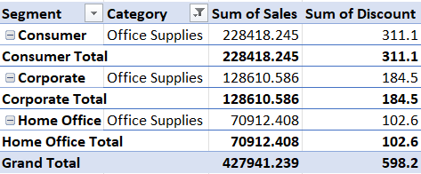
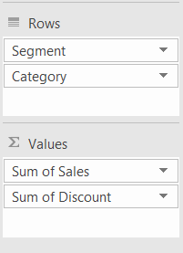
KEY METRIC CALCULATIONS :
TOTAL SALES:
ADJUSTED SALES:
AVERAGE SALES PER ORDER:
COUNTIF:
COUNTIFS:
SEGMENT BY SALES:
4

Slide 5
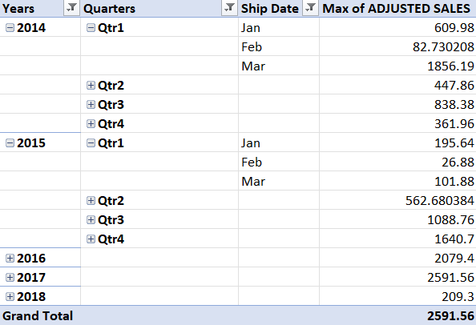
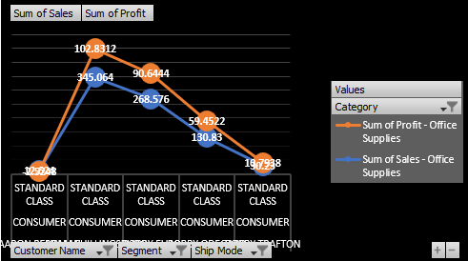
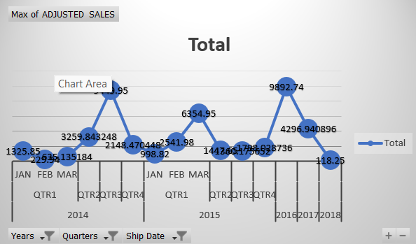
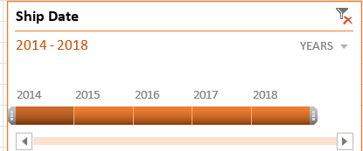
PIVOT TABLE AND PIVOT CHART:
TO MAKE SENSE OF LARGE SALES DATA,I CREATED PIVOT TABLES AND PIVOT CHARTS TO DYNAMICALLY SUMMARIZE AND ANALYZE KEY DIMENSIONS.
PIVOT TABLE:
PIVOT CHART:
TIMELINE FOR PIVOT TABLE:
5

Slide 6
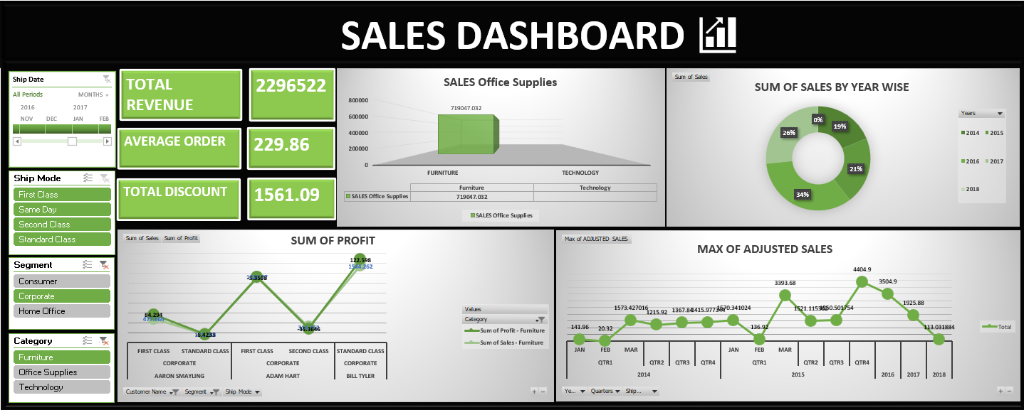
DASHBOARD OVERVIEW:
IT INCORPORATES ESSENTIAL COMPONENTS SUCH AS:
KPIs FOR QUICK PERFORMANCE ASSESSMENT.
2.CHARTS FOR TREND ANALYSIS.
SLICERS FOR DYNAMIC FILTERING AND DATA EXPLORATION IT IMPROVES DECISION MAKING.
6

Slide 7

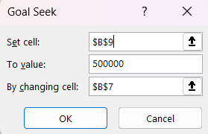
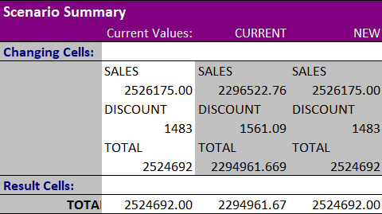

WHAT-IF ANALYSIS AND GOAL SEEK:
GOAL SEEK:
GOAL SEEK IN EXCEL IS MAINLY USED TO FIND THE INPUT VALUE NEEDED TO ACHIEVE A SPECIFIC RESULT IN A FORMULA.
1.SET THE TOTAL AMOUNT.
2.SET THE TARGET VALUE.
3.SET BY CHANGING UNIT SOLD VALUE.
SCENARIO MANAGER:
TO ANALYZE AND COMPARE MULITPLE SETS OF INPUT VALUES TO SEE HOW THEY AFFECT YOUR RESULTS.
1.THE CURRENT SALES INCRESED BY 10%.
2.THE CURRENT DISCOUNT DECREASED BY 5%.
7

Slide 8
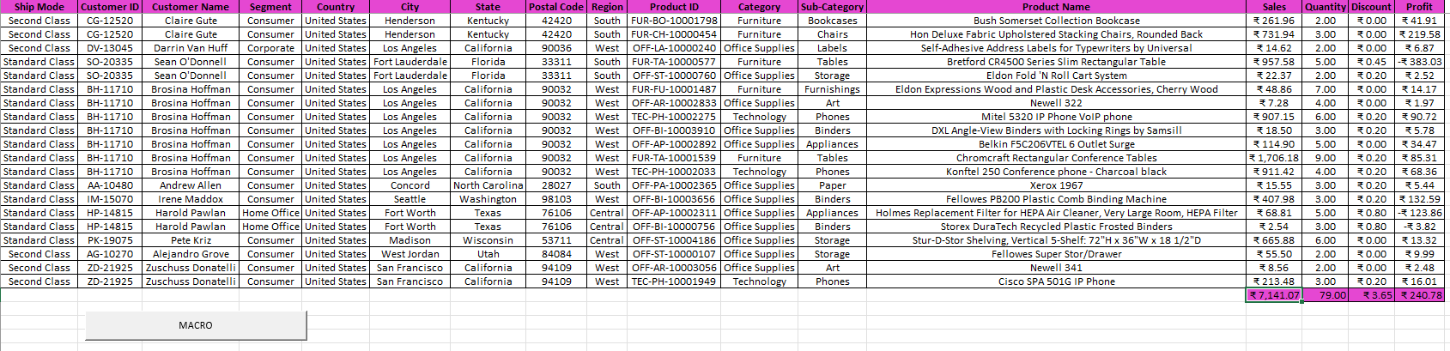
MACROS AND AUTOMATION:
HOW TO RECORD A MACRO:
GO TO DEVELOPER TAB->CLICK RECORD MACRO.THEN GIVE YOUR MACRO A NAME(NO SPACE),ASSIGN A SHORTCUT KEY(OPTIONAL),AND CHOOSE WHERE TO STORE IT.
THEN DO THE TASKS YOU WANT TO AUTOMATE LIKE FORMATTING CELLS,APPLYING FORMULAS AND SORTING DATA ETC..,
THEN GO BACK TO THE DEVELOPER TAB->CLICK STOP RECORDING.
BENEFITS OF MACROS:SAVES TIME,REDUCES ERRORS,CUSTOM WORKFLOWS.
8

Slide 9
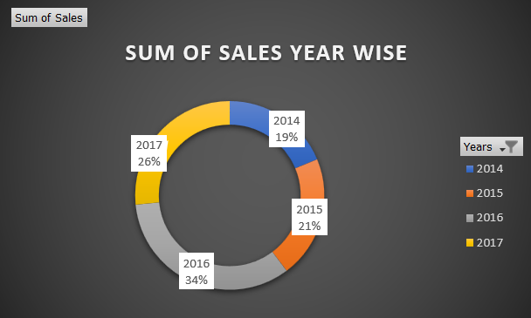
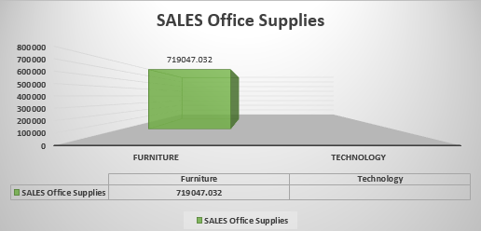
INSIGHTS AND RECOMMENDATIONS:
INSIGHTS:
THIS SHOWS THE MOST IMPACTFUL DISCOVERIES FROM YOUR SALES ANALYSIS.
BY USING THIS WE CAN FIND THE TOP-PERFORMING PRODUCTS OR CHANNELS.
WE CAN ALSO FIND THE IMPACT OF DISCOUNT ON THE SALES.
WE CAN FIND THE SEASONAL PATTERNS OF THE SALES WHERE WE FIND THE SALES RATE CAN HIGHER AND SALES RATE IS LOWER.
RECOMMENDATIONS:
BOOST INVENTORY FOR HIGH-PERFORMING CHANNELS TO AVOID STOCKOUTS.
TO OFFER TARGETED DISCOUNTS ON LOW-PERFORMING PRODUCTS DURING LOW SEASONS.
9

Slide 10
CONCLUSION:
BY THIS WE CAN REVEALS THE KEY TRENDS IN CUSTOMER BEHAVIOUR,SEASONAL SALES PERFORMANCE AND PRODUCT PREFERENCES.
THE TOP-PERFORMING CATEGORIES SIGNIFICANTLY CONTRIBUTE TO REVENUE,WHILE UNDERPERFORMING SEGMENTS OFFER ROOM FOR IMPROVEMENT.
IMPLEMENT PREDICTIVE ANALYTICS TO FORECAST SALES FOR THE UPCOMING QUARTERS OR YEARS.
EXPLORE CUSTOMER SEGMENTATION STRATEGIES TO TAILOR PROMOTIONS EFFECTIVELY.
ANY QUESTIONS?
10

